Slide 1




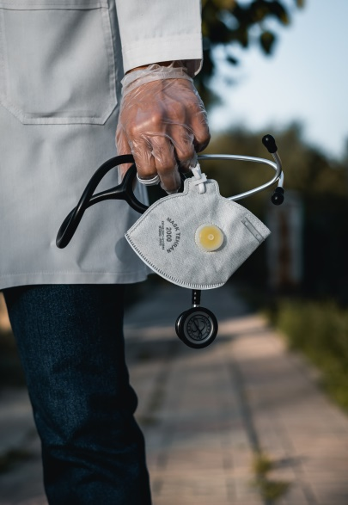

Presented by :-
Avinash Mishra
Sarthak Shadangi
Sudhansu Sekhar Pradhan
Machine Learning project to predict the doctor’s fee

Slide 2
Presented by :-
Sudhansu Sekhar Pradhan
Machine Learning project to predict the doctor’s fee

Slide 3

Objective
Create a machine learning model to
predict doctor’s fee
Creating a webpage for user to get accurate
prediction of fee based on multiple factors

Slide 4

About Practo:-
Practo is an online doctor’s
appointment and consultation app

Slide 5
Web Scraping
We used Selenium for scraping.
We also used BeautifulSoup for scraping.

Slide 6
Web Scraping
We used Selenium for scraping.
We also used BeautifulSoup for scraping.

Slide 7
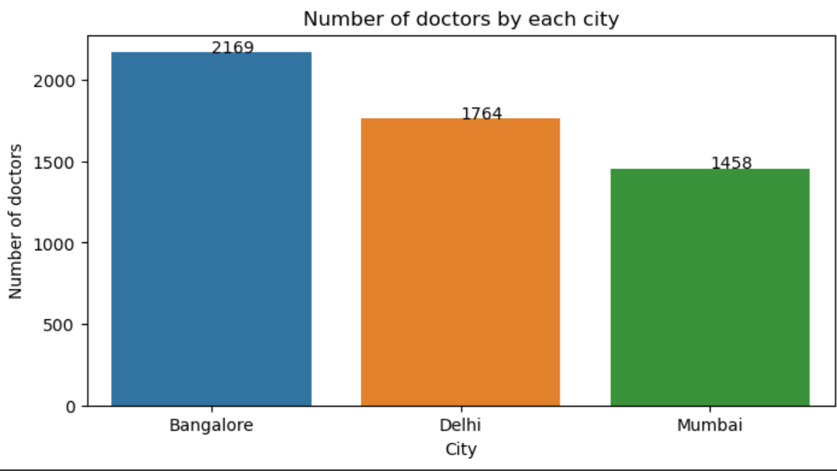
Data cleaning
Pandas for Data Cleaning
Null values handled
Outliers removed

Slide 8
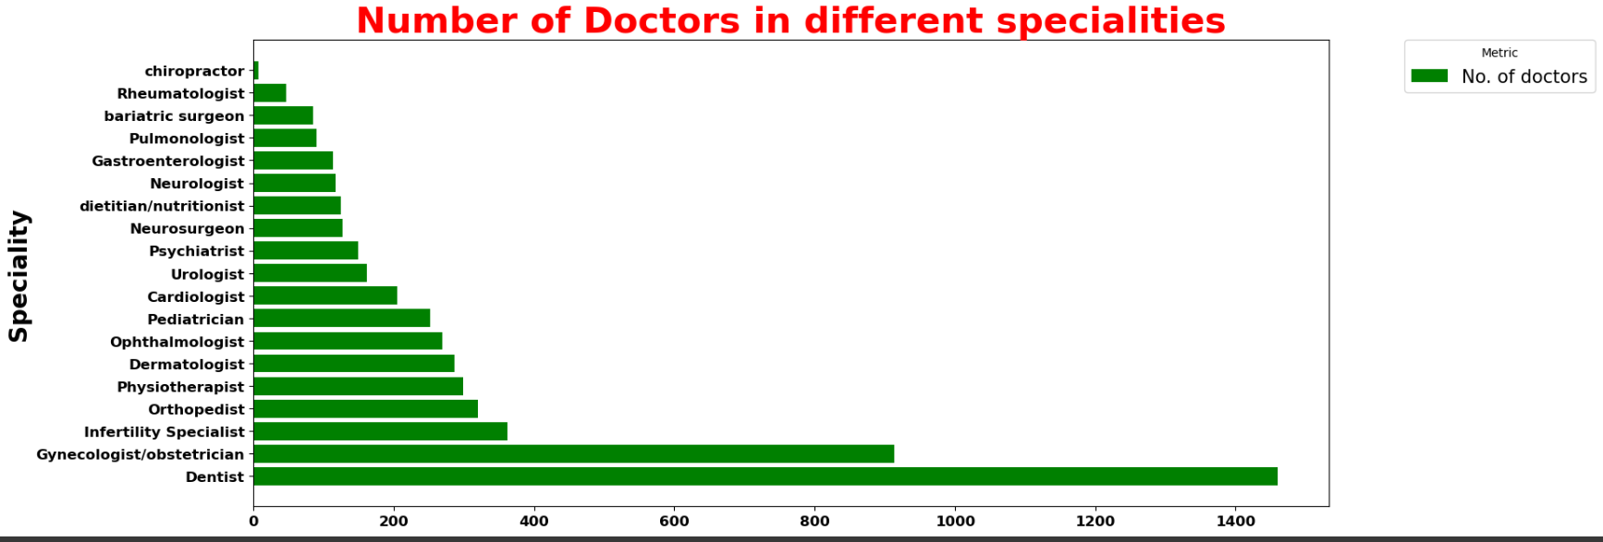
Insights
highest number of doctors

Slide 9
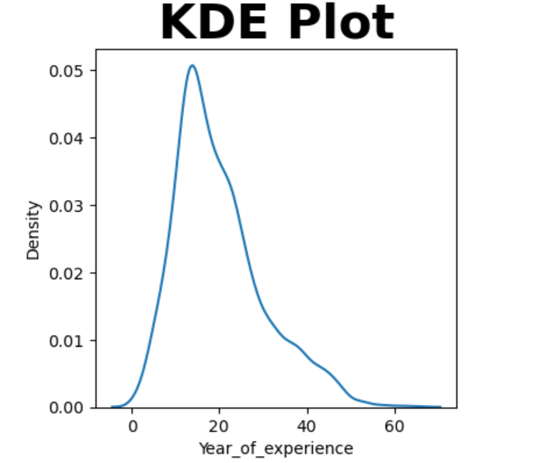
Insights
Dentistry has the highest number of professionals.

Slide 10
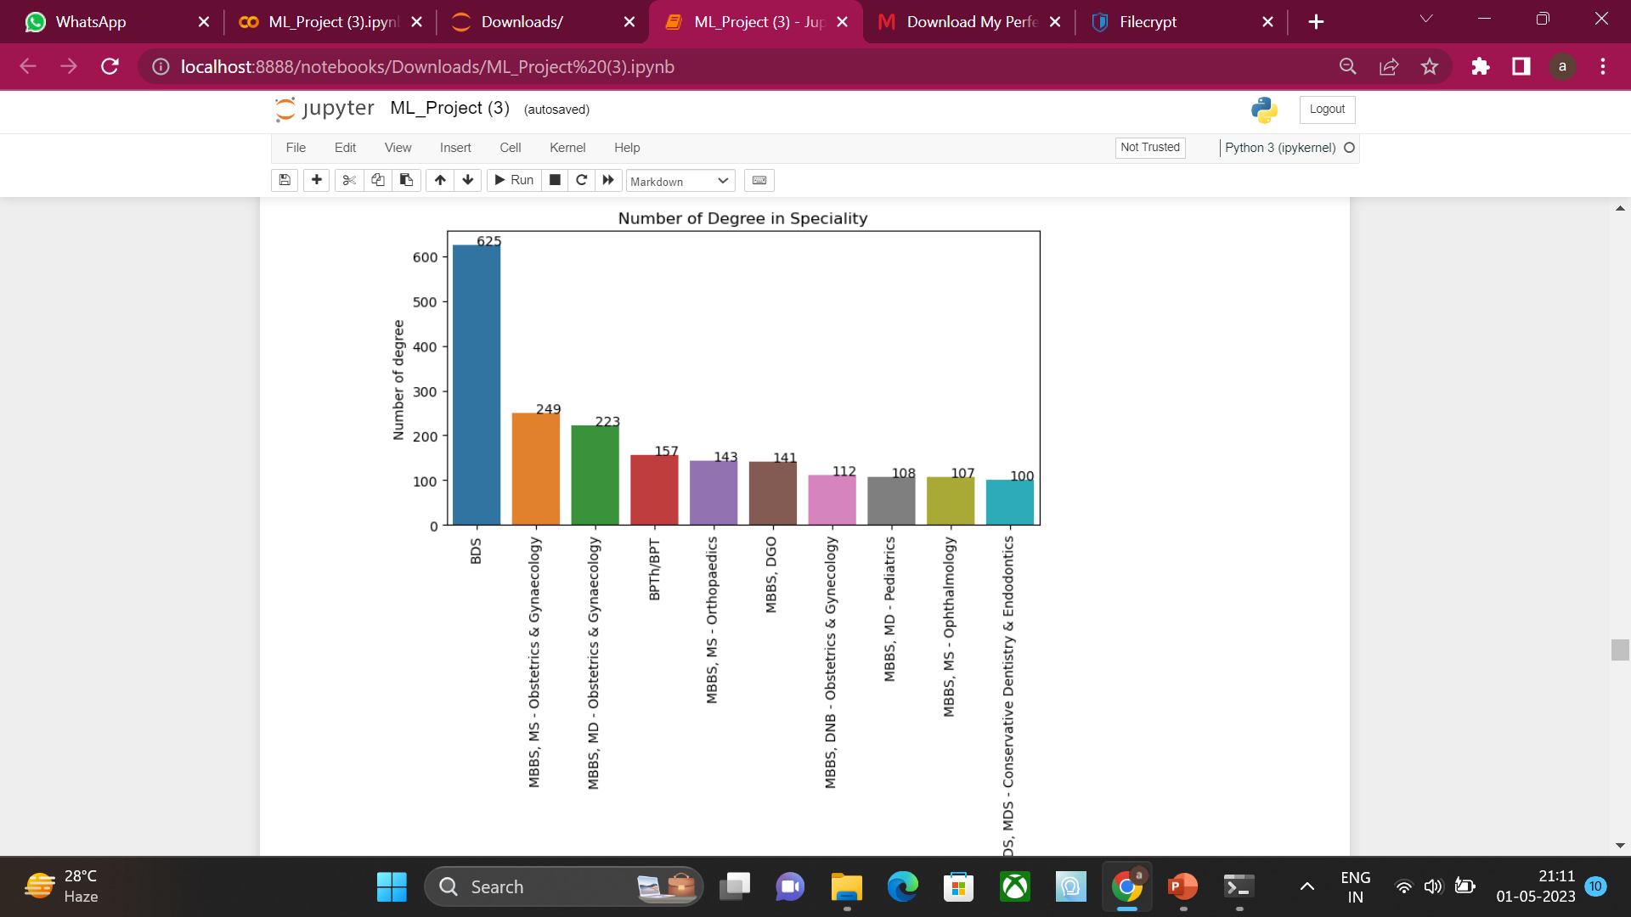
Insights
Majority of Doctors fall in 13-15 years Experience group

Slide 11
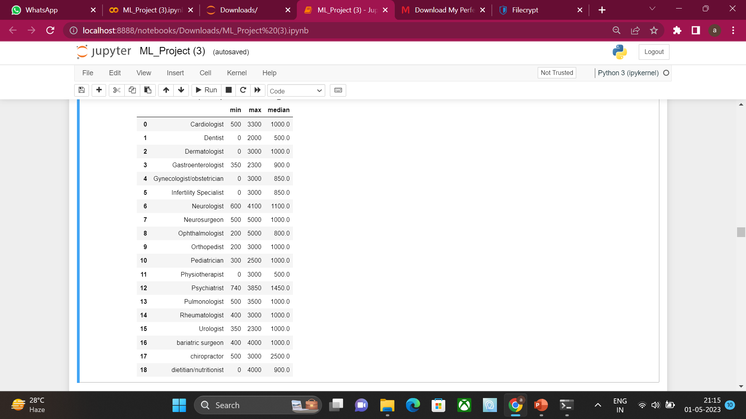
Insights
Bds is the most common degree

Slide 12
Insights
Cardiologist and neurologist
charge the highest

Slide 13

Machine Learning model
Linear regression model to predict
Fee’s

Slide 14

Webpage for user
HTML for webpage
Used JavaScript to make webpage responsive

Slide 15
Problems Faced
Using Flask to deploy machine learning model
Usage of html and JavaScript and their integration

